Slide 1

The Mysterious Death of Roland Greene
An SQL Advance Analysis of Evident Data.
By LearnWithWida Intermediate Team A

Slide 2

The Fateful Evening: June 1, 2025
A timeline of events leading to the discovery of Roland Greene's body.
7:55 PM
1
Last call received
2
7:57 PM
Last seen alive
8:00 PM
3
Gunshot heard
4
8:03 PM
Security feed cut
8:05 PM
5
Emergency call made

Slide 3


The Suspects Emerge
Four individuals with motives and questionable alibis.
Victor Shaw
Robin Ahmed
Rival. Mastermind. Conflicting alibi.
Family Doctor. Last seen with victim.
Jamie Bennett
Susan Knight
Staff. Misdirection. Accessed crime scene.
Investor. Cut security feed. Coordinated roles.

Slide 4
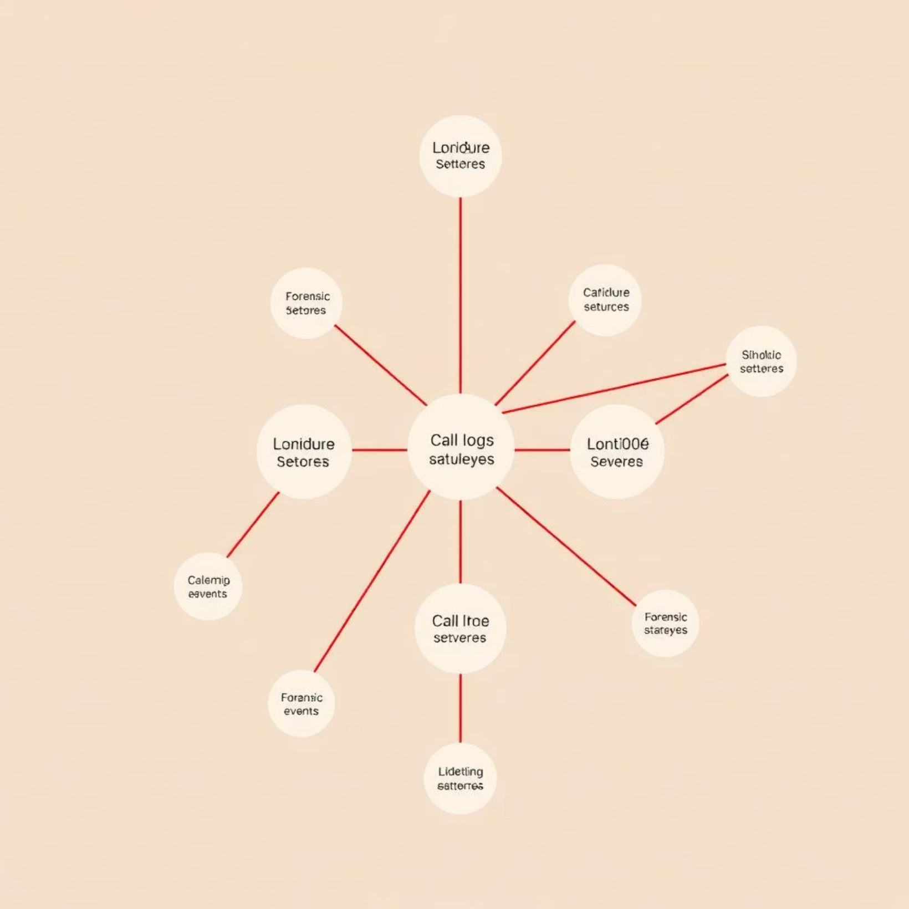
Unravelling the Evidence
Connecting the dots: call logs, access data, and forensic insights.
Cross-referencing call logs, access logs, and forensic events reveals a web of interconnected actions.
Suspect movements near the vault room during the critical window (7:55–8:05 PM) show suspicious activity.

Slide 5




Alibis Under Scrutiny
Inconsistencies that cast a shadow of doubt.
Victor Shaw's Call
Phone records don't match his alibi.
Jamie Bennett's Entry
Access logs show unscheduled presence.
Susan Knight's Action
Security feed cut during the critical moment.

Slide 6
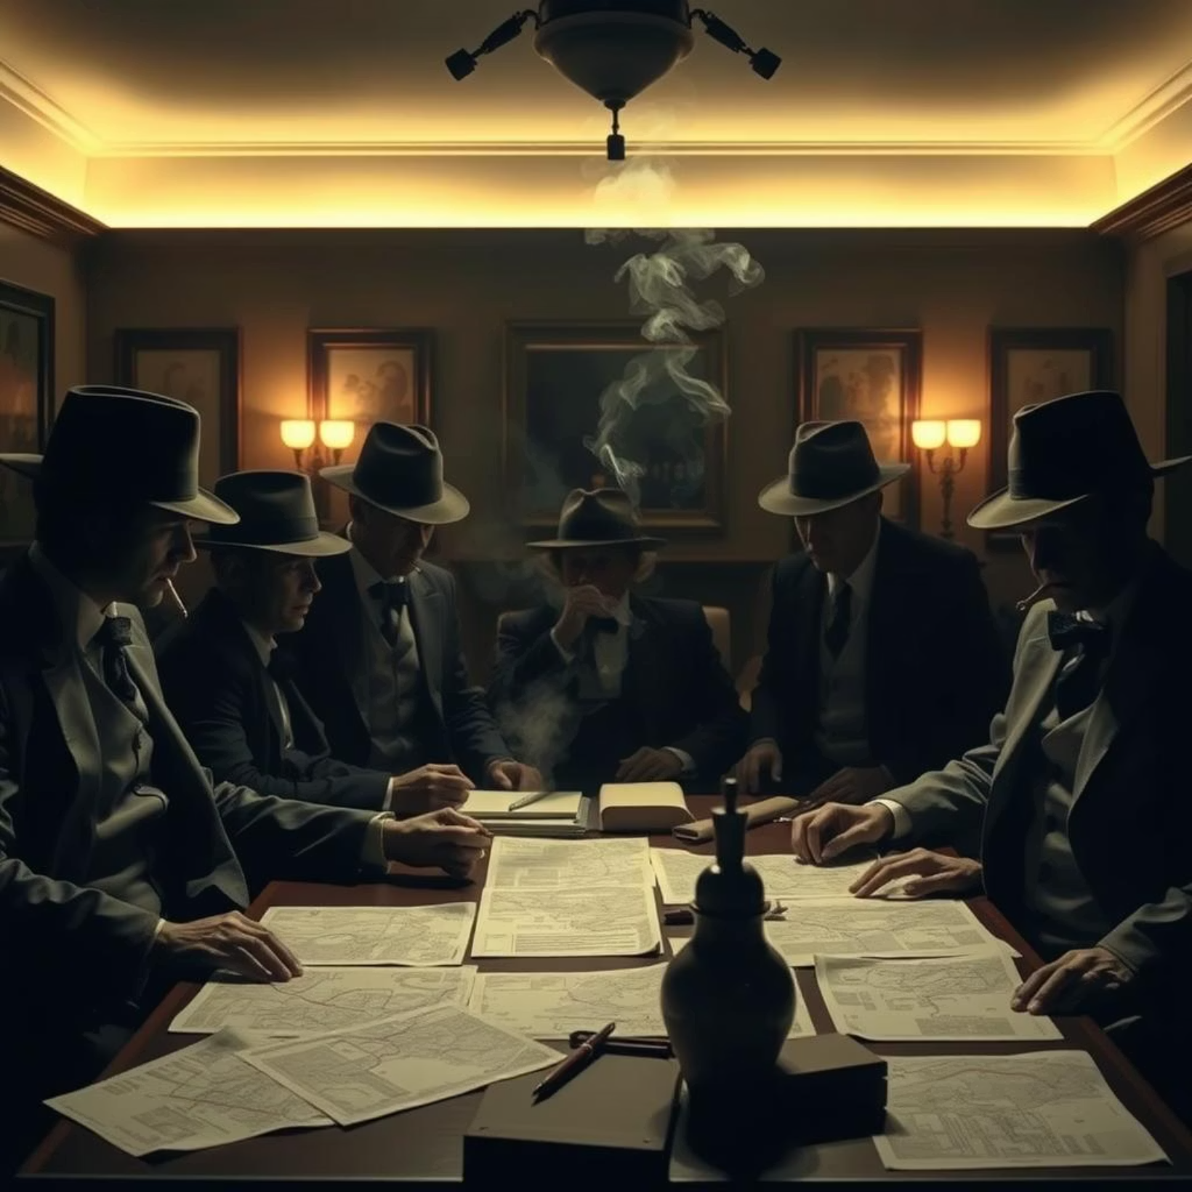
The Coordinated Conspiracy
Each player's role in the intricate plan.
Victor Shaw: The orchestrator, pulling strings from the shadows.
Robin Ahmed: Near the victim at 7:57 PM, providing a crucial window.
Jamie Bennett: Moving through the hallway post-gunshot, creating diversions.
Susan Knight: Disabling security at 8:03 PM, ensuring no witnesses.

Slide 7

The Mastermind Revealed
All trails lead back to one man.
"A coordinated murder, meticulously planned, with Victor Shaw as the undisputed mastermind."

Slide 8

Justice Awaits?
The case of Roland Greene: a chilling narrative of greed and deception.
Will the pieces fall into place and bring closure to this dark chapter?

